Slide 1
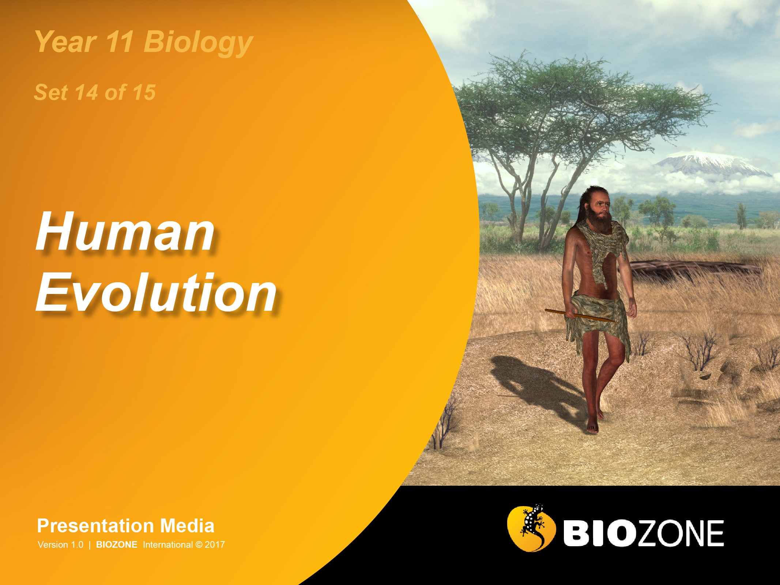

Slide 2
Primates
Primate classification
Primate characteristics
Human evolution
Dating fossils
Human characteristics
Analysing DNA
The changing environment
Human evolution timeline
Human origins
Origin of modern humans
Dispersal out of Africa
Ardipithecus
Nakedness and bipedalism
Dentition
“Lucy”
Homo floresiensis
The human brain
Cultural evolution
Tool cultures
Fire
Clothing
Shelter
Art and culture

Slide 3


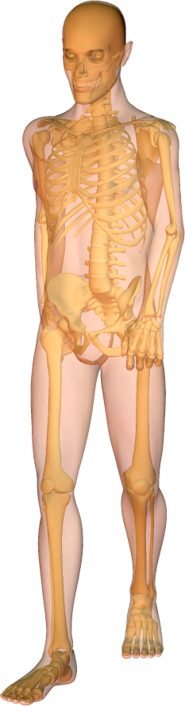
Human Characteristics
Teeth covered with thick ename. Reduced molars, small canines
Enlarged brain
High forehead
Head held vertically
Reduced neck muscles
Shortened forelimb
Reduced lower back with S-shaped curvature
Short, wide pelvis for attachment of gluteal muscles for walking
Fully opposable thumb
Leg bones are thickened and longer
Femoral head angled and strengthened
Reduction in body hair to increase evaporative cooling
Buttress at knee-joint to allow bipedal walking
Foot has an arch with weight-bearing heel and ball
Non-opposable and forward thrusting big toe

Slide 4
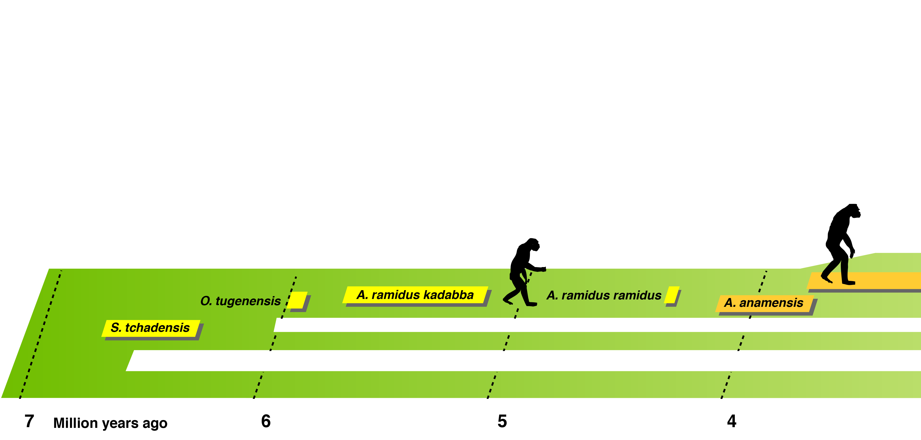
Human Evolution Timeline
A number of fossil hominin species from the period 3.5 to 6.5 million years ago have been discovered in recent years.
They have been assigned to the following genera:
Sahelanthropus
Orrorin
Ardipithecus
Australopithecus

Slide 5
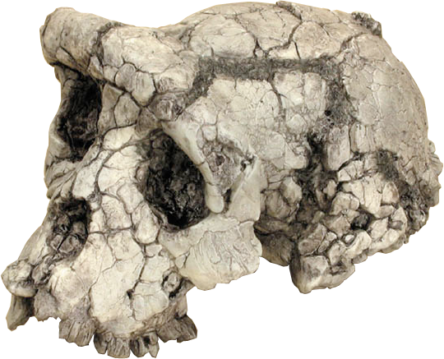
Human Evolution Timeline
In 2001, the 6-7 my old remains of a nearly complete skull with gorilla-like features was unearthed in Chad.
The find was nicknamed “Toumai” and assigned to a new genus, Sahelanthropus. Analysis of the cast of the interior of the braincase provides support for it being classified as a hominin.
Photos courtesy of: SkullsUnlimited.com

Slide 6
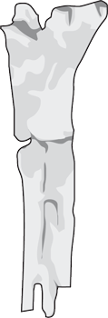
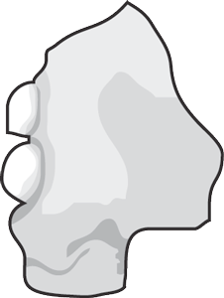

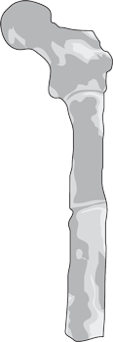

Human Evolution Timeline
Orrorin tugenensis, or ‘Millennium man’ was discovered in late 2000 at a site in Kenya.
Photos courtesy of: SkullsUnlimited.com

Slide 7
Human Evolution Timeline
Ardipithecus ramidus: Originally given the name Australopithecus ramidus, it was reclassified under a new genus, Ardipithecus.
Two subspecies have been identified:
A. ramidus ramidus (4.4 my old)
A. ramidus kadabba (5.8 my old)
Regarded by some researchers as ‘simply an ape with some unusual characteristics’.

Slide 8
Human Evolution Timeline
Australopithecus anamensis: Discovered at Kanapoi, Kenya in 1994, this earliest known species of the genus Australopithecus had a mixture of primitive, ape-like features and advanced, human-like features.

Slide 9
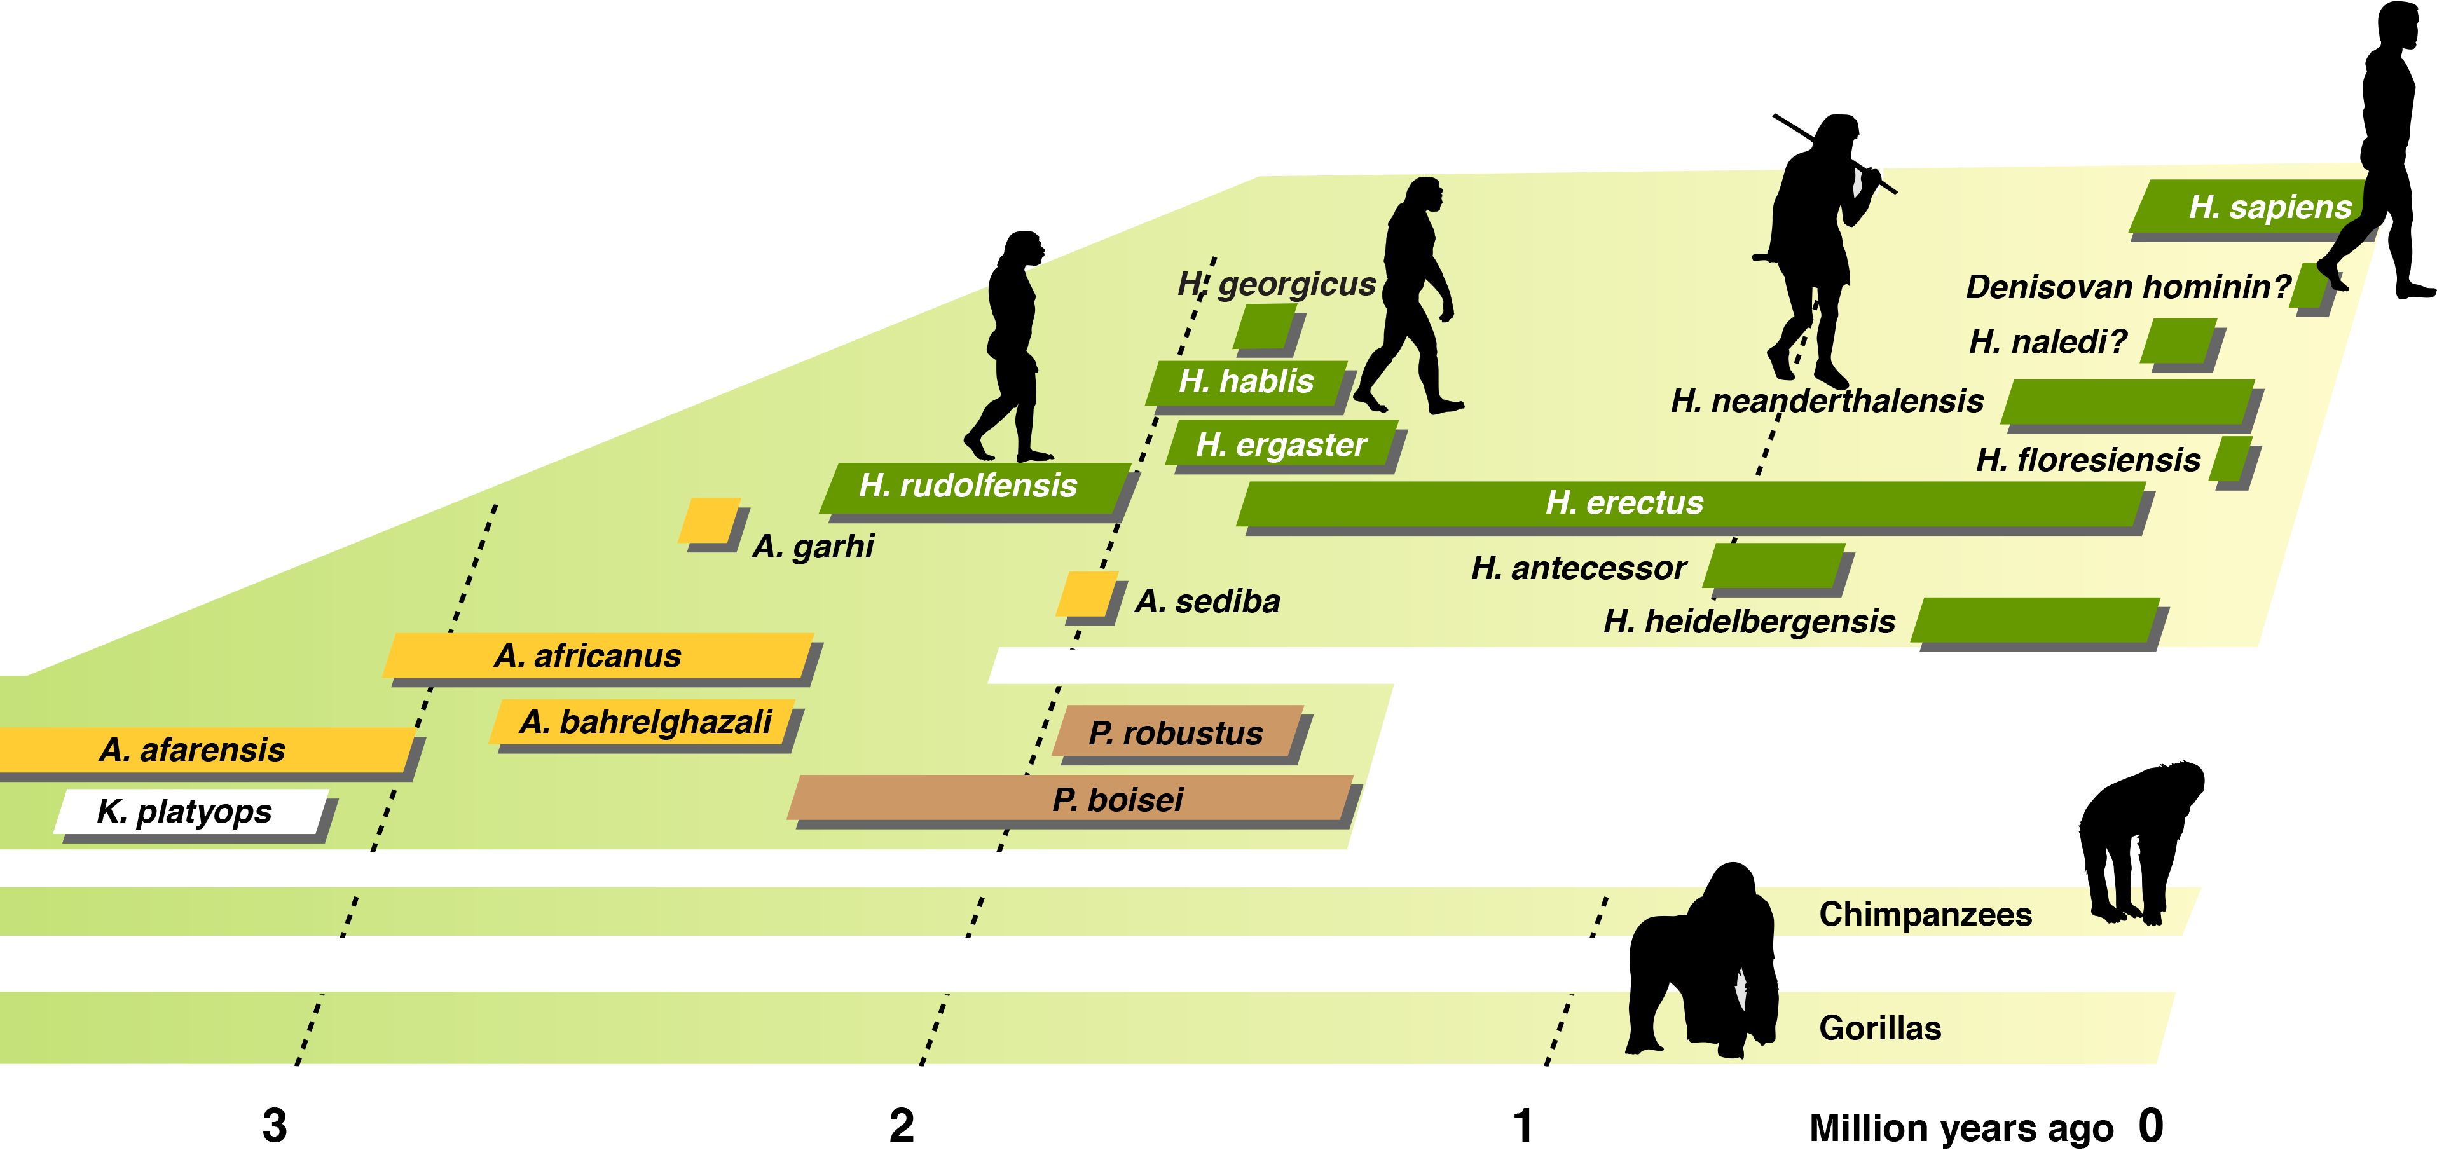
Human Evolution Timeline
The last 3 million years have seen a series of adaptive radiations among the more recent hominin groups:

Slide 10
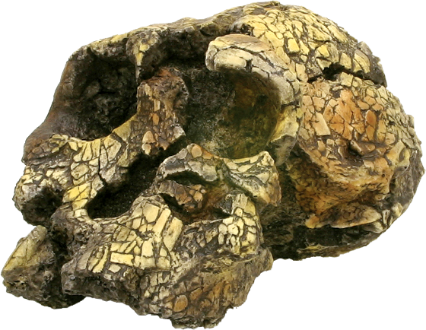
Human Evolution Timeline
Discovered in Kenya, a new genus Kenyanthropus appears to be an offshoot from the main evolutionary branches
Photos courtesy of: SkullsUnlimited.com

Slide 11
Human Evolution Timeline
As many as four species from the genus Australopithecus emerge, with a wide geographic distribution, ranging from southern Africa, through East Africa, to Chad in the north.

Slide 12
Human Evolution Timeline
A group of species from the genus Paranthropus* emerge in southern and eastern Africa. They coexisted with the emerging genus Homo and were superbly adapted to exploit low grade vegetarian diet.
* Designated Australopithecus in some sources

Slide 13
Human Evolution Timeline
The first species of genus Homo emerges from a probable Australopithecine ancestor. A small-brained species with fully developed bipedal locomotion, it has a talent for shaping tools from stone. This hominin does not venture out of Africa.

Slide 14
Human Evolution Timeline
What followed was an adaptive radiation of the genus Homo, leading to increased body height, brain capacity, complex social behaviour, and a geographic distribution that extended well beyond Africa.

Slide 15
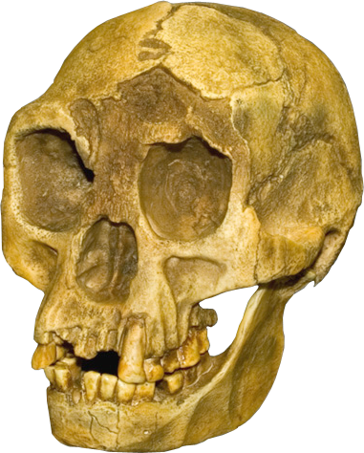
Human Evolution Timeline
A recent, and perhaps quite perplexing part of this emerging story, is the discovery in 2003 of what appears to be a ‘pygmy’ species of human that lived on the Indonesian island of Flores between 190,000 - 50,000 years ago.
Photos courtesy of: SkullsUnlimited.com

Slide 16
Human Evolution Timeline
Recent DNA evidence suggests that fossils found in the Denisovan caves are from a previously unknown hominin that may have been related to the Neanderthals.
Photos courtesy of: SkullsUnlimited.com

Slide 17
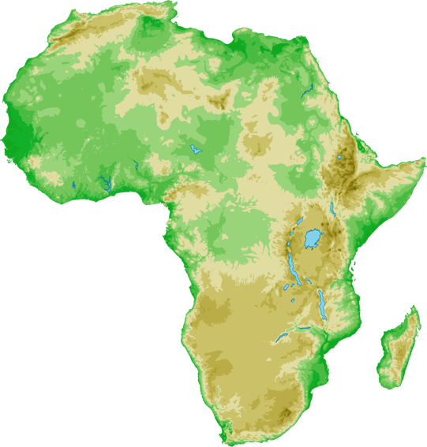
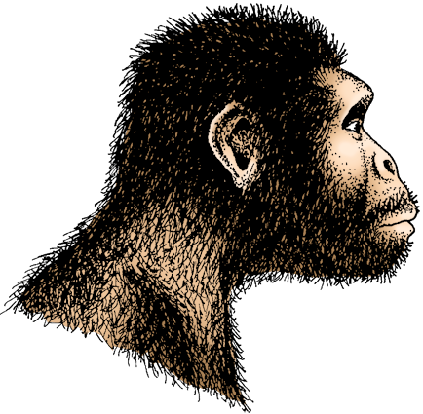
Australopithecus afarensis
Lucy, the First Family, and the Laetoli footprints are assigned to A. afarensis.
A small, gracile,biped. Brain volume estimated at between 375-550 cc, but generally <500 cc. Lived 3.9-3.0 MYA.
The skull is similar to that of a chimpanzee, except for more human-like teeth.
The human-like pelvis and leg bones confirm they were bipedal.
Height ranges from 1.0 to 1.5 m (sexual dimorphism*).
* Some researchers claim such differences in height suggest two separate species, not sexual dimorphism.

Slide 18
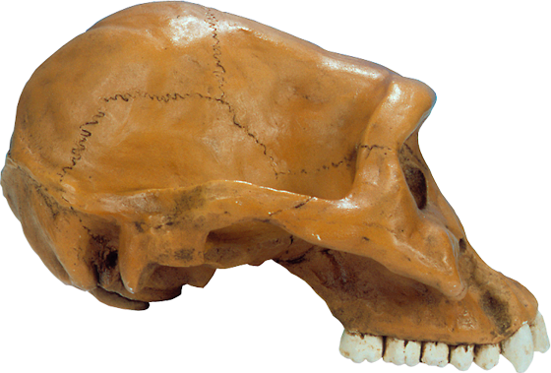
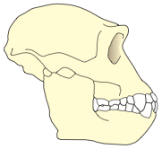
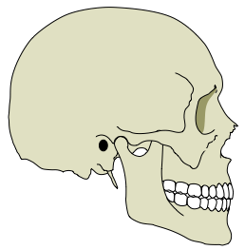
Australopithecus afarensis
Small brain
(375-550 cc)
Low forehead
Brow ridge
Large, dish-
shaped face
Wide midface
Flat nose
Big, ape-like incisor
Little of the skull is behind the foramen magnum
Diastema (gap)
Large, thickly
enamelled molars
Canines larger
than in humans
A modern human skull
(for comparison)

Slide 19
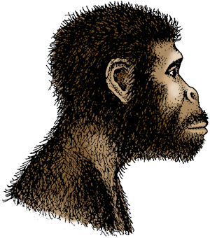
Australopithecus africanus
A. africanus existed between 3.9 and 3.0 MYA.
Similar to A. afarensis, it was also small, gracile, and bipedal, but slightly larger in size.
Brain size may also have been slightly larger on average, ranging from 420 to 500 cc.
Generally considered to be specific to South Africa.
Differs from the early australopithecines in east Africa by having larger back teeth and smaller canines. The jaw shape is fully human-like.

Slide 20
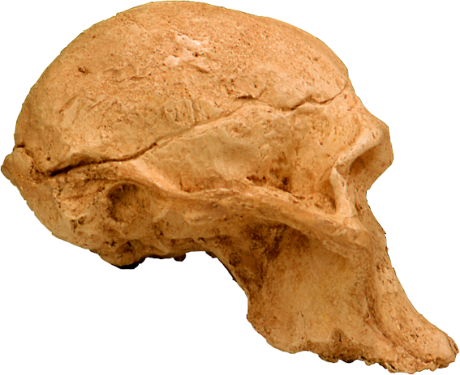
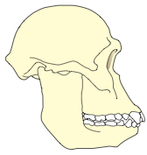
Australopithecus africanus
Small brain (420-500 cc)
same size as gorilla's
but organisation is
different from an ape's
No sagittal crest
Brow ridge
Low facial angle
Lower face
protrudes forward
into a snout
(prognathism)
Very large molars compared with modern humans (not shown here)
A modern human skull
(for comparison)

Slide 21
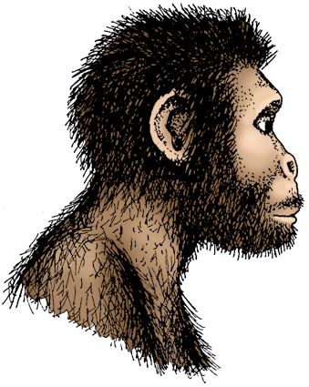
Homo habilis
Existed between 2.4 and 1.5 MYA.
Although similar to australopithecines in many ways, their brain size was considerably larger.
Some researchers argue that this species is too variable in its present classification. Instead, they propose that it be split into two species:
Homo habilis (ER-1813)
Homo rudolfensis (ER-1470)
One habilis brain cast shows a bulge of the Broca’s area, suggesting rudimentary speech.

Slide 22
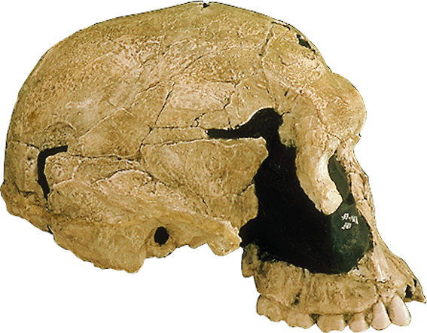
Homo habilis
Bigger brain
(500-650 cc for small variant)
Rounded cranium with no sagittal crest
Bulge in the Broca's area of the brain for speech production
Brow ridge
Large variant
Smaller, narrower face than the australopithecines
Flat nose
Small variant
Projecting jaw
(prognathism)
More of the skull is behind the foramen magnum
Jaw is less massive than in the australopithecines
Tooth row displays a modern curve, with narrow molars
A modern human skull
(for comparison)

Slide 23

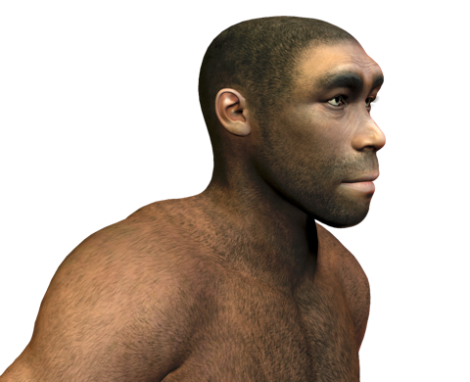
Homo erectus
Homo erectus is reserved for the later Asian forms (shown here), with dates ranging from 1 million to 300,000 years ago.
Thought to be the first humans to venture out of Africa.
They differ from H. ergaster by having skulls that were strongly buttressed with ridges of bone, skull walls greatly thickened, and larger brain volumes.
These simple hunter-gatherers used stone tools and fire. Nicknames: Java Man, Peking Man, Solo Man.

Slide 24
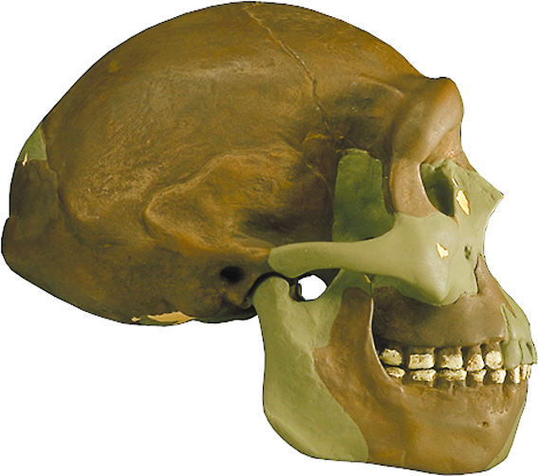
Homo erectus
Bigger brain with increase over time, although body size was also increasing
1000-1250 cc
Bulge in the Broca's
area of the brain for
speech production
Long, flattened cranium with a distinctive keel along the top
Bulge in Wernicke's area of the brain for speech recognition
Shelving forehead
More recent Asian forms
Thick brow ridge
Flat face
Older
African forms
Occipital bun
(bun-like swelling)
Projecting
jaw
Attachment for strong neck
muscles to stop the head
from sagging forward
Teeth are smaller than
H. habilis, but more
massive than our own
A modern human skull
(for comparison)
No chin

Slide 25
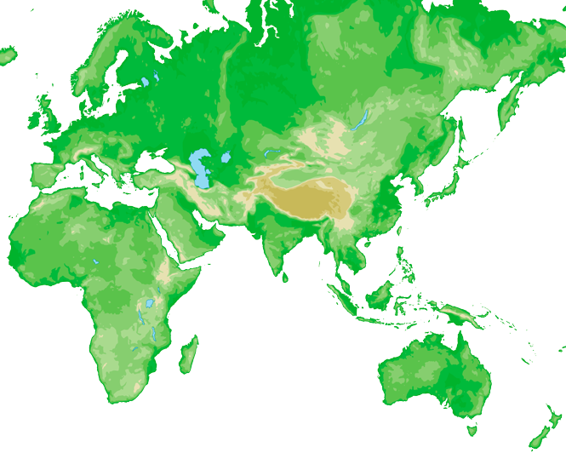
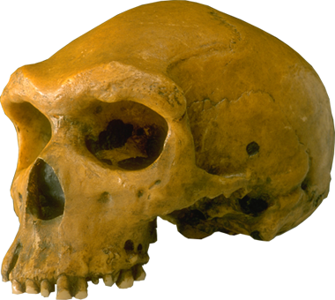
Homo heidelbergensis
About 300,000 years ago transitional archaic forms appear in increasing variation and numbers.
Possessing both modern and Homo erectus-like features, they were probably 'experimental prototypes' responding to diverse regional selection pressures.
Most researchers refer to this variable collection of early (archaic) Homo sapiens as a separate species: Homo heidelbergensis.

Slide 26
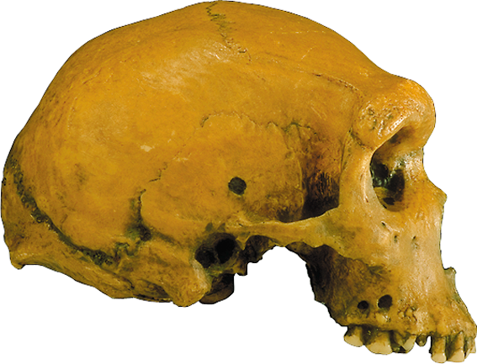
Homo heidelbergensis
Large brain
(1100 - 1400 cc)
Flat, oblong shape to the cranium
Sloping forehead
Large brow
ridge
Broad, upright
face
Broad nasal opening
Occipital 'bun'
for neck muscle
attachment
No muzzle (no prognathism)
Teeth are generally
modern in form
A modern human skull
(for comparison)

Slide 27
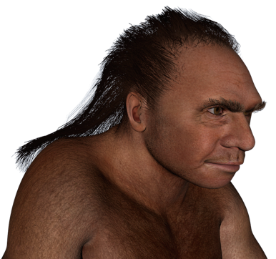
Homo neanderthalensis
Neanderthals existed between: 230,000 and 28,000 years ago.
They had short, squat, cold-adapted bodies with thick and heavy bones.
Recent research suggests that the Neanderthals split off from the line to modern humans nearly 600,000 years ago.

Slide 28
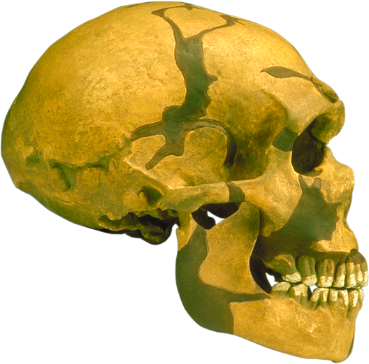
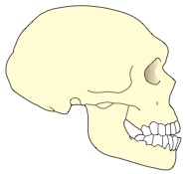
Homo neanderthalensis
Large brain (1200-1750 cc)
Larger than a modern
brain but organised differently
Low, long cranium
Sloping forehead
Double-arched
brow ridge
Occipital bun
Large prominent nose and mid-facial projection
Swept back,
lightly built
cheek bones
Skull widest at the base (unlike modern skulls which are widest near the top)
Powerful jaw but
reduced compared
to H. erectus
Weak chin
Teeth are smaller
than H. erectus, but
bigger than our own
A modern human skull
(for comparison)

Slide 29
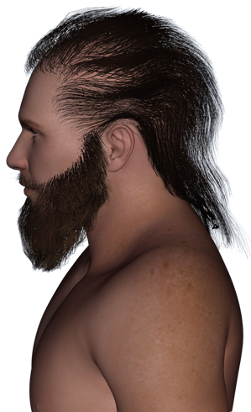
Homo sapiens
The first anatomically modern humans appear about 200,000 years ago in southern African and the Middle East.
They underwent a sudden cultural revolution about 40,000 years ago, with the appearance of Cro-Magnon culture.
Using a wider range of materials, their tools kits became markedly more sophisticated.
They were (and are) skilled hunters, tool-makers and artists (cave art and music).

Slide 30
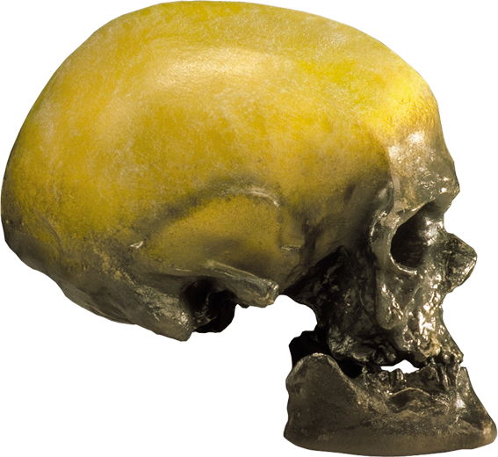
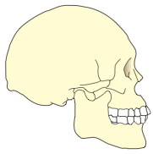
Homo sapiens
Large brain
(1200-1700 cc)
Convex cranial vault
High, vertical
forehead
Skull widest
high up
No brow ridge, just a slight swelling of the glabella
Vertical
face
Low, rounded
occipital area
No muzzle
(no prognathism)
Sizeable mastoid
process
Reduced tooth size
with thinner enamel
Sizeable jaw with
projecting chin
A modern human skull
(for comparison)

Slide 31
Ardipithecus ramidus
First discovered in 1994 in the Middle Awash region of Ethiopia, the Ardipithecus ramidus fossils have changed our view of human origins.
The partial skeleton of Ar. ramidus has provided information the origins of bipedalism, and the evolution of the human hand.
Other name | Two subspecies: A. ramidus ramidus A. ramidus kadabba
Known date | 4.4 - 5.8 million years ago
Brain size | 300-350 cc
Height | c. 1.2 m
Physique | Bipedal forest dweller.
Skull shape | Foramen magnum more forward than apes.
Teeth and jaws | Smaller, narrow molars; thinner jaw
Geographical distribution | Eastern Africa

Slide 32
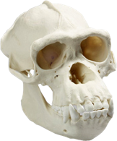
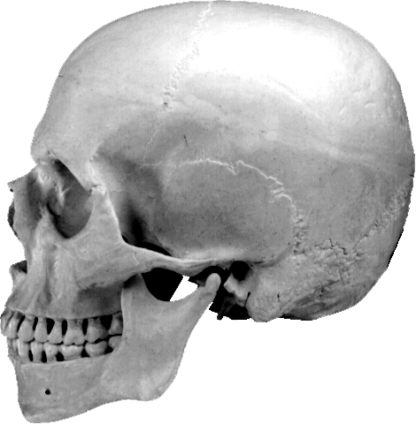
The Split from CLCA
Pan (chimpanzee)
- Knuckle walker
- Skilled climber
- Short stiff back
- Grasping feet
- Strengthened wrist and elongated palm
- Large incisors for eating fruit
- Similar size in male and females
- Canine teeth in males larger than in females
Homo
- Habitual upright walker/biped
- ‘S’ shaped flexible lower back
- Multiple environment omnivore
- Similar size in males and females
- Small canines in males and females
Gorilla
Ardipthecus
- Facultative upright walker
- Able tree climber
- Retained long flexible lower back
- Woodland and forest omnivore
- Similar body size in both sexes
- Small canine in males
CLCA
The simplified evolutionary tree of hominids below shows that chimpanzees continued to evolve into a specialised tree climber and are not simple modifications of the Chimpanzee-human Last Common Ancestor (CLCA). Indeed the CLCA was an ape-like creature with many generalised features that have undergone further modification in both humans and chimps alike.

Slide 33
Ardi’s Skull
The skull of Ar. ramidus shares certain features with Australopithecus.
There is a reduction of the canine teeth in male and females.
This implies a reduction in aggression between males.
The orientation of the base of the skull on which the brain stem rests suggests that the parts of the brain involved in visual and spatial perception were already beginning to develop.
Relatively small cheek bones
Reduced canine teeth
Brow ridge
Prognathic muzzle
Diagrams redrawn from C. Owen Lovejoy, et al, Science Vol 329 2009

Slide 34
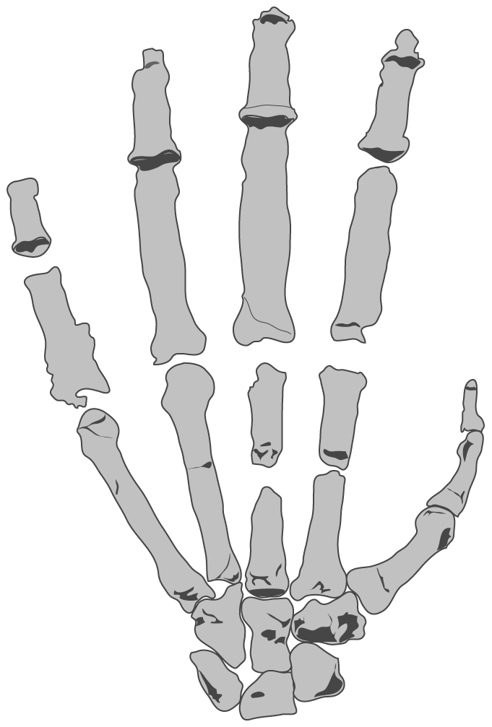
Ardi’s Hand
Analysis of the hand of Ar. ramidus shows that it is similar to our own.
This means human hands are closer to the primitive form (i.e. to the last common ancestor of apes and humans) than once thought, and that the knuckle walking hand of chimpanzees and gorillas is the modified form.
Ar. ramidus had a flexible wrist and well developed opposable thumb.
Short metacarpals
Lack of strengthened knuckles
Well developed thumb
Short flexible palm
Primitive hand features shared by Ardipithecus and Homo
Diagrams redrawn from C. Owen Lovejoy, et al, Science Vol 329 2009

Slide 35
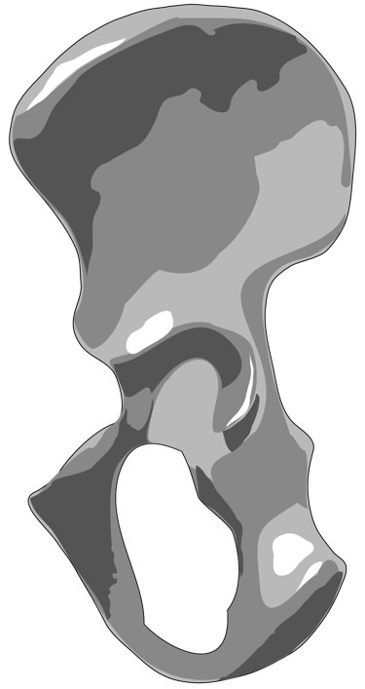
Ardi’s Pelvis
The pelvis of Ar. ramidus indicates that the modern pelvis, adapted for bipedal locomotion, began its evolution in the trees.
Several features of the upper pelvis (short and broad ilium) indicate bipedalism.
However, several other features in the lower pelvis show that there were well developed tree climbing muscles.
Ar. ramidus exploited both the arboreal and terrestrial environment. A suite of adaptations must have been important in reproductive success.
Features associated with bipedalism that are shared by Ardipithecus and Homo
Feature associated with tree climbing that is shared by Ardipithecus and Pan
Diagrams redrawn from C. Owen Lovejoy, et al, Science Vol 329 2009

Slide 36
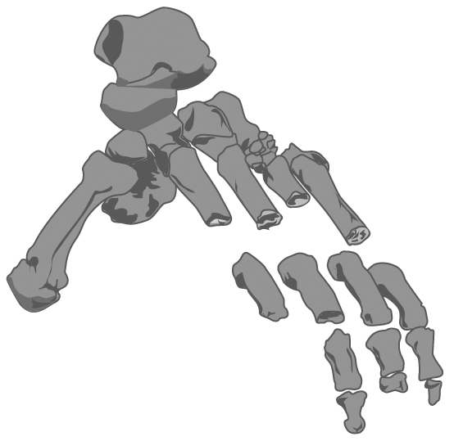
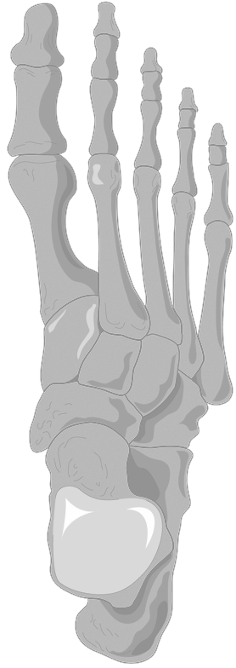
Ardi’s Foot
The foot of Ar. ramidus is generalised with some human-like features, such as a rigid central foot bones.
It also shows some features of modern apes such as an opposable big toe.
These features show Ar. ramidus spent considerable time climbing trees.
Ardipithecus ramidus foot
Big toe points to the side
Big toe points forward
The central foot bones are rigid in both Ardipithecus and Homo.
Homo sapiens foot
Diagrams redrawn from C. Owen Lovejoy, et al, Science Vol 329 2009

Slide 37
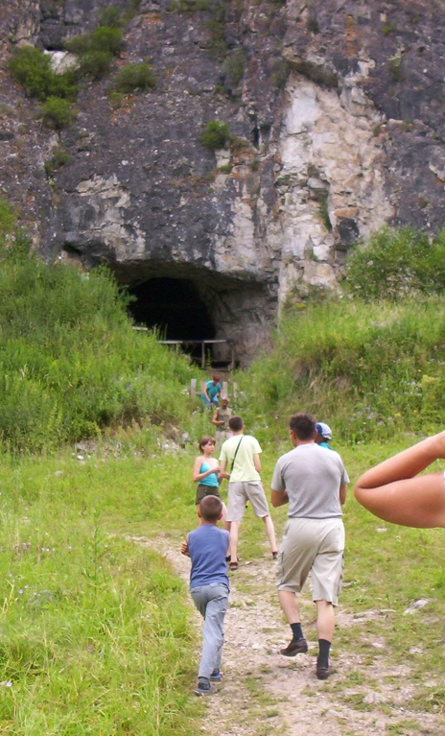
The Denisova Cave Find
In 2008 archeologists discovered a fragment of finger bone in the Denisova cave, in Siberia. The bone fragment belonged to a juvenile female.
A molar was found in 2010 and a toe bone in 2011, both from different individuals.
The characteristics of the molar indicated it may have been from an previously unknown human species.
The cool temperatures in the cave preserved the DNA in the fossil fragments, allowing some DNA to be extracted.
Photo: Obersachse

Slide 38
Analysis of the DNA
Analysis of the Denisova specimen’s DNA suggests it belongs to a new species of human.
The Denisovans may a been a sister group to the Neanderthals and probably shared a recent common ancestor.
The Denisovans may have interbred with the ancestors of present day Melanesians, and appear to share 4%-6% of their DNA with them.
African
French
Han Chinese
Melanesian
Interbreeding ~80,000 years ago
Interbreeding ~40,000 years ago
Denisova
~ 400,000 years ago
?
Vindija Neanderthal
~ 300,000 years ago

Slide 39
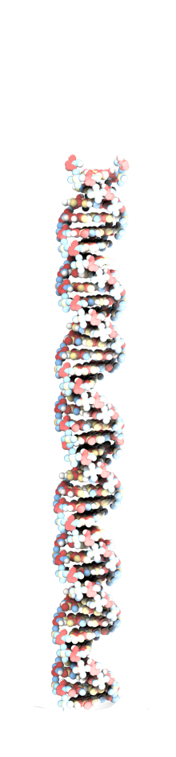
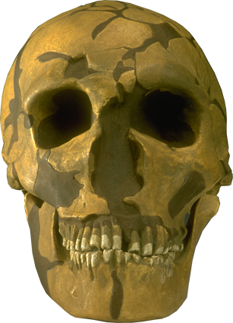
Analysing Neanderthal DNA
The DNA in ancient bone fragments is often degraded and fragmented.
Between 95%-99% of the DNA extracted from Neanderthal fossil is from microbes that colonised the bone after the Neanderthal died.
Findings suggest the Neanderthal DNA is 4 billion base pairs long.
The genomes of modern humans and Neanderthals is 99.7% the same.
Interbreeding may have occurred 80,000-50,000 years ago, resulting in 1%-4% of Eurasian DNA being derived from Neanderthals.
Neanderthals are more closely related to present day non-Africans than to Africans.

Slide 40
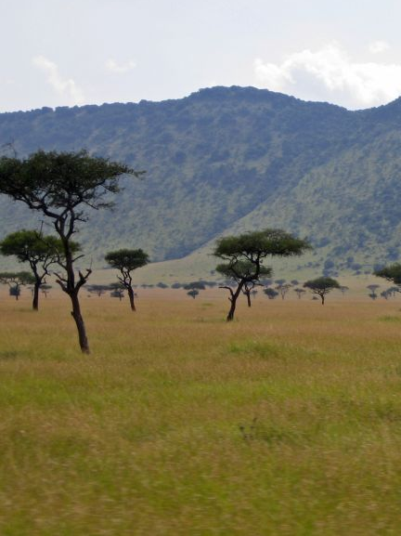
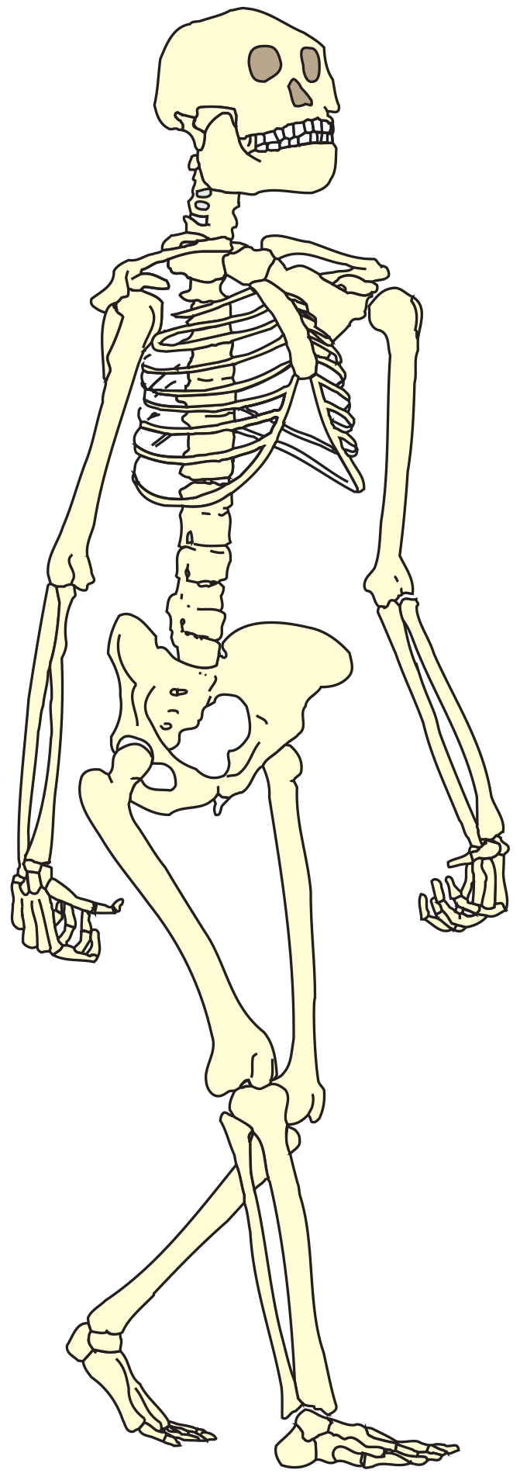
The Primitive Features of 'Lucy'
Jaw shape half way between V-shape of ape's and U-shape of human jaw
Sexual dimorphism in the canine teeth (a primitive trait)
This is a reconstructed skeleton of ‘Lucy’ Australopithecus afarensis – one of the earliest known bipedal hominins.
The skeleton exhibits features consistent with a species adapted for walking bipedally ....
But it also possesses many ‘primitive’ features normally associated with an arboreal existence.
Shoulder joint that is orientated towards the head
Chest (thorax) is funnel-shaped
Relatively long arms compared to legs
Wrist has high mobility
Finger bones are curved
Relatively short legs
Ankle joint is highly mobile
Toes are long and curved
Redrawn from a photograph by © David L. Brill 1985

Slide 41
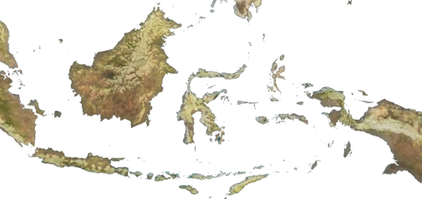
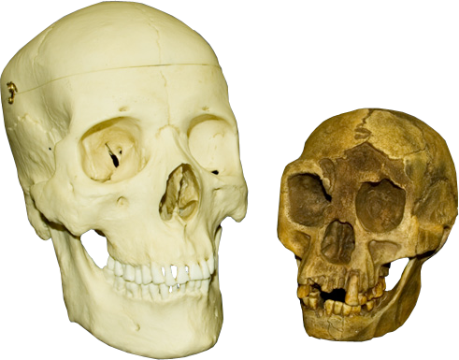
Homo floresiensis
Borneo
Discovered in 2003 on the Indonesian island of Flores, nicknamed ‘the hobbit’, these hominins lived 190,000 - 50,000 years ago.
The dimensions of the skull and skeleton of H. floresiensis fall well outside the extremes seen in H. sapiens.
It is equal to the smallest known australopithecines, and approaches that of modern chimpanzees (which have a brain size of 400 cc).
New Guinea
Sulawesi
Sumatra
Flores
Java
Timor
H. floresiensis skull shown next to a modern human skull to show its size.
Photo courtesy of: SkullsUnlimited.com

Slide 42
Homo floresiensis
Fossils from a number of individuals include a 30 year old female with a brain size of 380 cc and standing just 1.0 m tall.
One theory was that the species resulted from long-term isolation, with subsequent endemic dwarfing, of an ancestral Homo erectus population (dwarf forms of large mainland mammal species are not uncommon on islands).
The fossils astounded scientists by showing clear signs that (despite their very small brain size) the species used stone tools and fire, and hunted dwarf elephants, also found on the island.
However, latest analyses support the theory that Homo floresiensis evolved in Africa and then migrated and probably shared a common ancestor with Homo habilis. It is far more primitive than Homo erectus and now not thought to have evolved from them as was originally thought.
H. floresiensis may have been part of the Asian dispersals of the descendants of H. ergaster and H. erectus.
Photo courtesy of: SkullsUnlimited.com

Slide 43
Homo floresiensis
Other name | The Hobbit
Known date | 190,000 - 50,000 years ago
Brain size | 380 cc
Height | 1.1 m
Physique | Small. Weight 25-30 kg. Arms relatively long compared to body and legs relatively short.
Skull shape | Relatively flat face, no chin. forehead small and sloping.
Teeth and jaws | Large compared to skull. Relatively modern dentition.
Geographical distribution | Flores island, Indonesia.
Arms: Long relative to the rest of the body
Wrist joints: Quite primitive as seen in early hominins
Legs and feet: Legs are very short relative to the rest of the body. The feet are large relative to the rest of the body.
Artists’s reconstruction of the LB1 skeleton, after William Junger, Stony Brook University

Slide 44
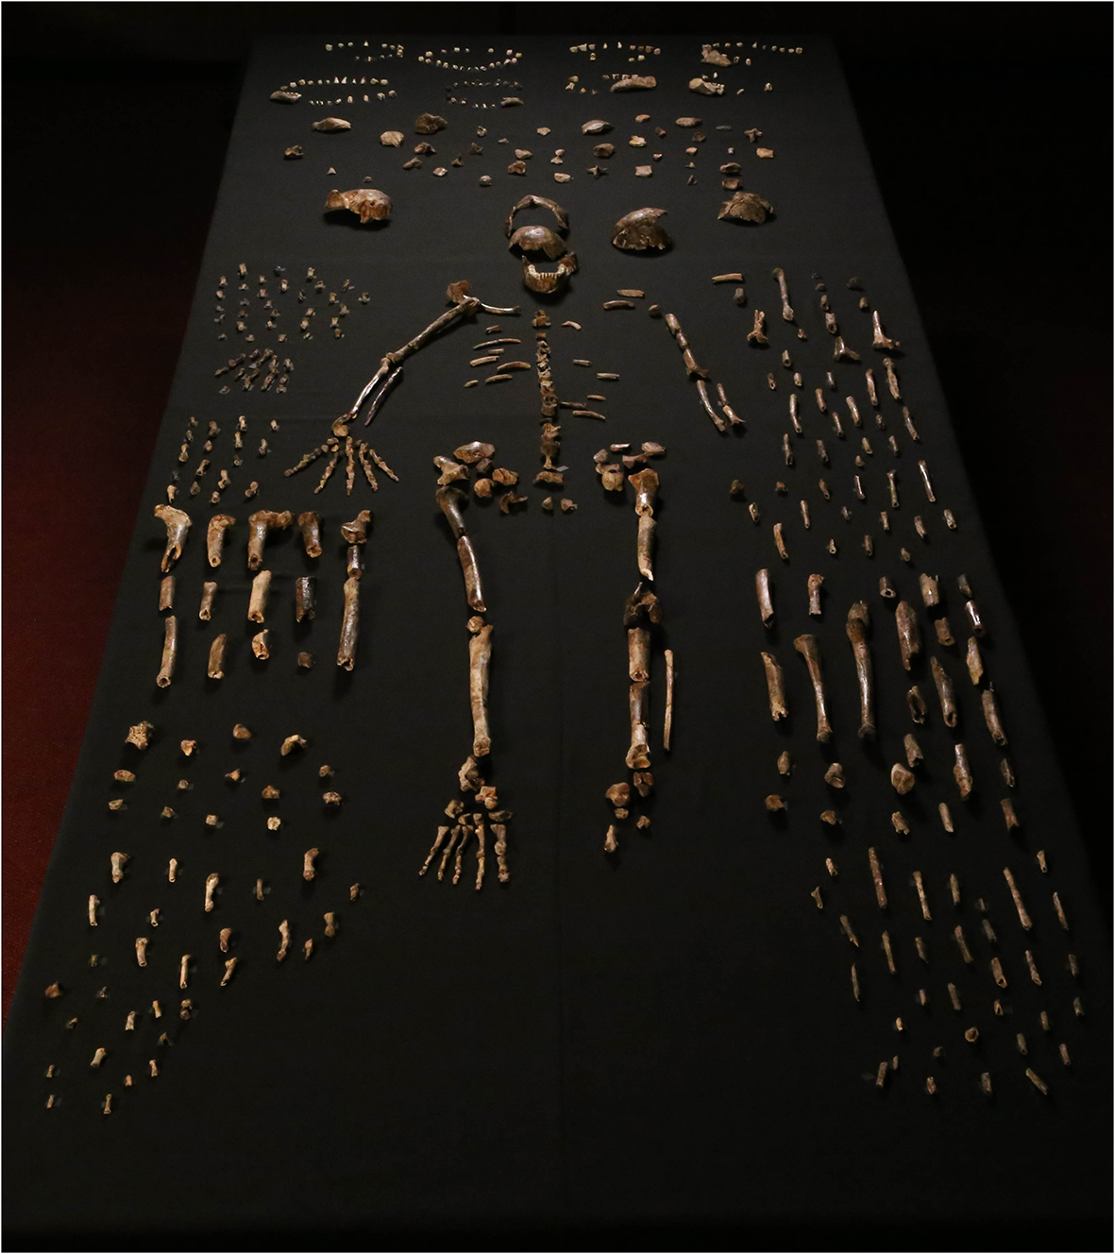
Homo naledi
In 2013 two cavers exploring the Rising Star cave system near Johannesburg in South Africa found a passage that led to a chamber containing the bones of a new hominin species.
Excavation has found more than 1500 specimens from at least 15 individuals including ribs, skulls, jaws, and dozens of teeth.
Interestingly, no other types of animal or plant have been found in the cave and there is no indication of water flowing in the past.
This has led the investigators to hypothesise that the bodies were deliberately placed there by other Homo naledi.
Lee R Berger

Slide 45
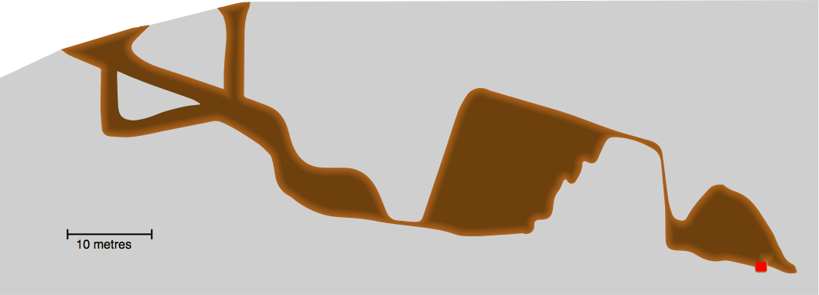
Rising Star Cave System
The region of the cave system in which the bones were found is difficult to access.
Cave entrance
Superman's crawl may have been higher in the past, allowing easier access.
Bodies were probably dropped down the shaft over a long period of time (maybe centuries)
Dinaledi chamber
Dragon’s back
Superman's crawl (less than 30 cm high)
Fossil find

Slide 46
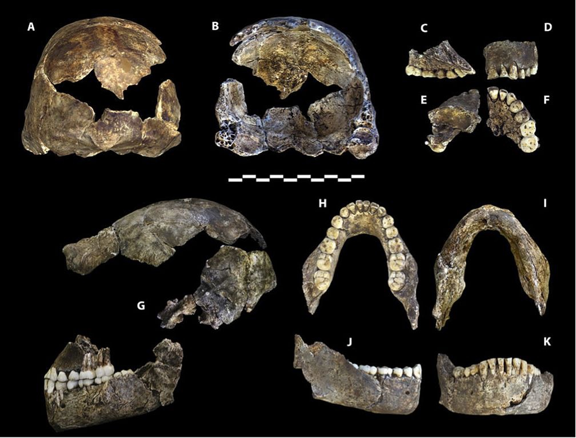
Dating H. naledi
Dating the Homo naledi bones is problematic because they were found deep in the cave.
Ordinarily, fossils can be dated by relative dating.
Other fossils in the sediment can be used to date the unknown fossils. For example, if the bones of a predator species of a known age had been found in the cave, then it may imply that H. naledi lived at the same time.
However, only H. naledi bones have been found, expect for a few small birds on the surface.
Various anatomical ways of dating the fossils were tried, initially providing a date of ~1-3 my. However, more recent radiometric dating of specimens and the overlying flowstones has provided a much more recent date of 335,000- 236,000 years.
Lee R Berger

Slide 47
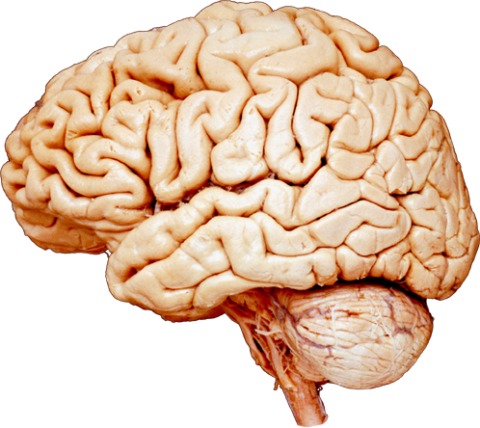
Brain Size Compared to Body Height
Brain size can be correlated to the body height of hominins.
A clear pattern emerges that indicates three distinct clusters of evolutionary development:
Australopithecines
Erectines
Homo
Homo floresiensis clearly falls outside these clusters.
Homo sapiens
Brain volume (mL)
Erectines
Homo naledi
Australopithecines
Homo floresiensis
Height (m)

Slide 48
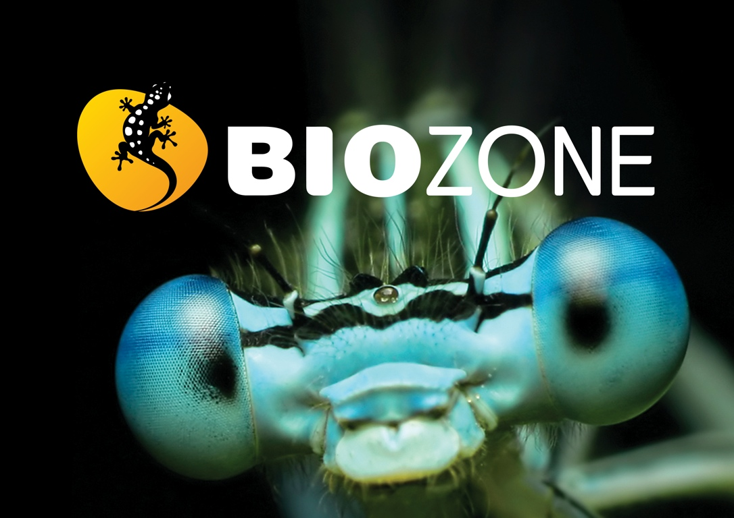

Slide 49
Conditions of Use
NOTE: Presentation Media = presentations available on CD-ROM/DVD-ROM or as downloads
BIOZONE retains copyright to the intellectual property included in the Presentation Media files, with acknowledgement that certain photos are used under license and are credited appropriately.
You MAY:
Use the Presentation Media files for presentations in your classrooms using a data projector, interactive whiteboard or overhead projector.
Place the Presentation Media files on any staff computer within the school, including staff laptops, but not in contradiction to clause (g).
Place the Presentation Media files on:
The school’s intranet (school computer network)
VLE (Virtual Learning Environment)
A CMS (Content Management System).
Student and staff access must be restricted to those who are enrolled/working on the campus of the registered purchaser. Student and staff access to a VLE or a CMS must be controlled by a user login and password protocol, but not in contradiction to clause (f). If students have access, they need to be made aware of the Conditions of Use and are only allowed to view the content.
Edit and customise the Presentation Media files by adding, deleting, and modifying information to better suit your needs, but not in contradiction to clauses 2 (c) - (d).
Print out the Presentation Media files in PowerPoint® or Keynote® “Handouts” mode for the express purpose of allowing students to make their own notes about the presentation, but not in contradiction to clause (e).
You MAY NOT:
Place the Presentation Media files on to the Internet or on a service that may be accessed off-campus unless access to the service is protected by a user login and password protocol, and is restricted to students and staff enrolled/working on the campus of the registered purchaser.
Place the Presentation Media files on student laptop computers.
REMOVE any of the references to BIOZONE, the title slides, copyright notices, photo credits, or Conditions of Use from the Presentation Media files.
Create a NEW document using any of the graphics/images in the Presentation Media files.
Print the Presentation Media files on to paper to make your own worksheets for distribution to students.
Incorporate any part of the Presentation Media files for the production of another commercial product.
Share or give away any content off-campus. This prohibition apples to, but is not limited to, sharing via the Internet or any website, (examples: YouTube, slide sharing websites).
Conditions of Use are subject to change without notice. Visit http://www.biozone.com.au/faqconditionsofuse/

Slide 50
Photo Credits
Photographic images are used under license from the following commercial photo libraries:
Corel Corporation Professional Photos (uncoded)
ArtToday.com (coded AT)
Clipart.com (coded CA)
PhotoObjects.com (coded PO)
iStock.com (coded iStock)
Hemera Technologies Inc. (coded Hemera)
Photos.com (coded PC)
Education interactive (coded EII)
Digital Stock (coded DS)
LifeArt (coded LA)
Dollar Photo Club (coded DPC)
3D models were created using Poser
Additional artwork and photographs are the property of BIOZONE International Ltd. All rights reserved.
Some 2D artwork has been adapted from TechPool STUDIOS LifeArt Collections, used under licence.
Images from the Public Domain: Where these licenses have been used, authors and licenses have been acknowledged alongside their image.
Centers for Disease Control (coded CDC)
National Institutes of Health (coded NIH)
National Aeronautics and Space Administration (NASA)
U.S. Department of Agriculture (coded USDA)
Images from the public domain include limited copyright, copyright expired, uncopyrighted, or uncopyrightable material:
Licenses including: GNU Free Documentation License http://www.gnu.org/copyleft/fdl.html
Creative Commons Attribution Share Alike http://creativecommons.org/licenses/by-sa/3.0/
Wikimedia Commons
NOTE: Where images are edited or moved from or within this file, the accompanying photo credit must be retained.

Slide 51
